Slide 1

Presentation of July-August 2024
Human Rights Dashboard

Slide 2
General Human Rights Situation
Human rights complaints to the NHRC continue to witness astronomical rise
Mass killings and abductions
Attacks on Police stations
Attacks on Press Freedom
Violations of the Rights to Freedom of Association and Protests
Killings of law enforcement and members of the Armed Forces
Rise in cases of violence against children and minors and child abandonment

Slide 3
NHRC July & August 2024 Human Rights Complaints

Slide 13
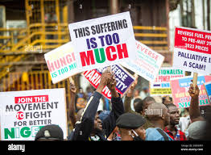

Slide 14
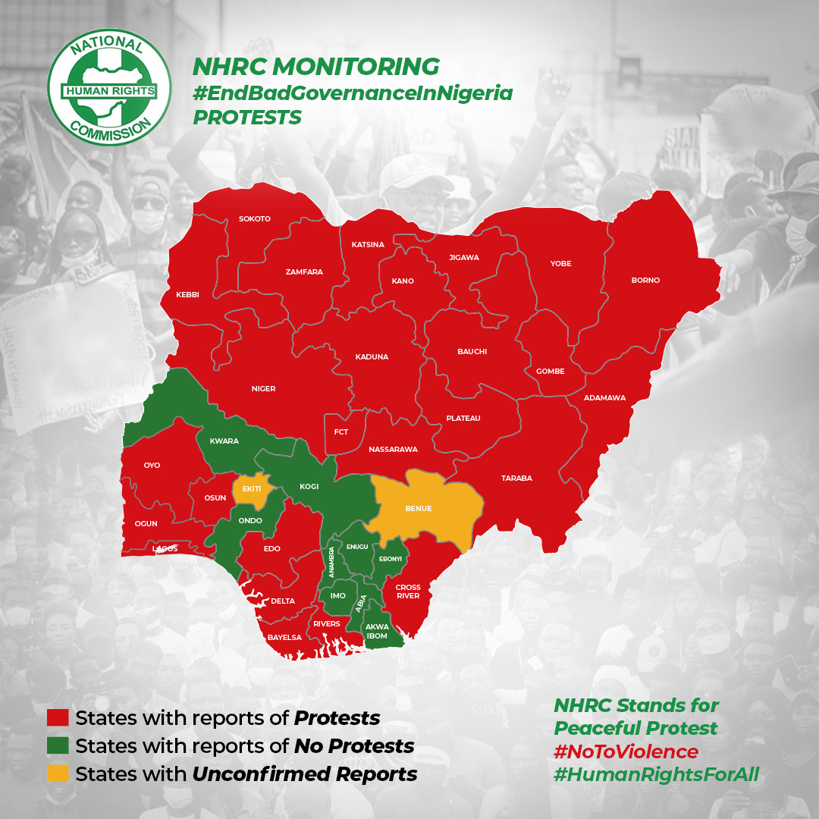

Slide 15
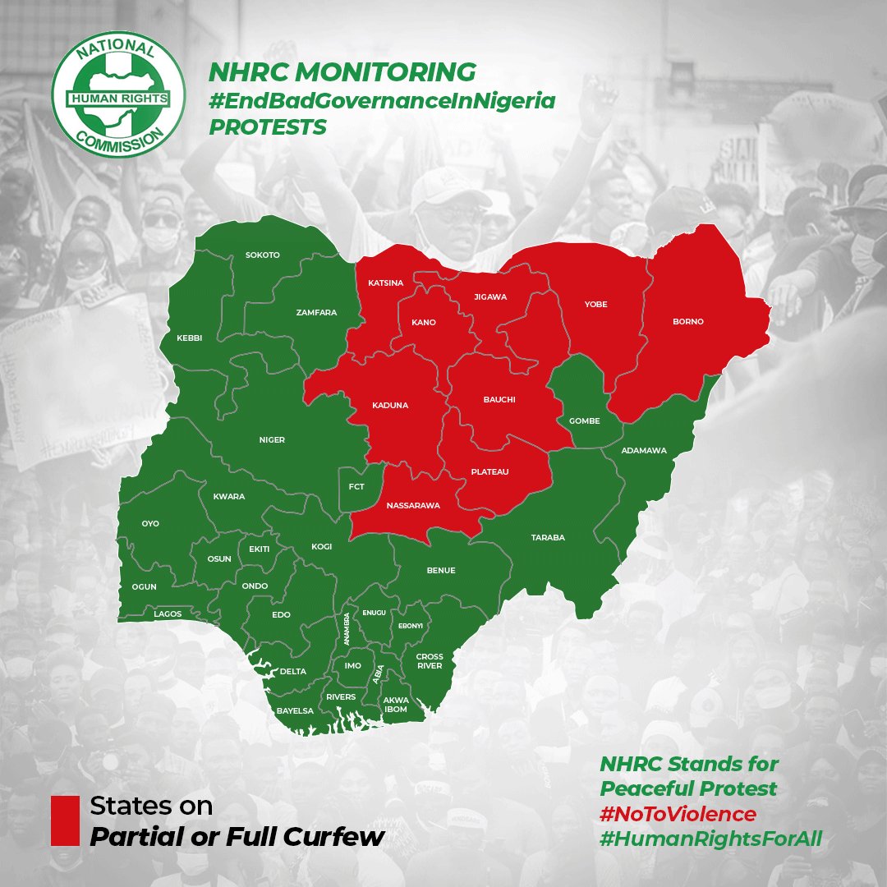

Slide 16
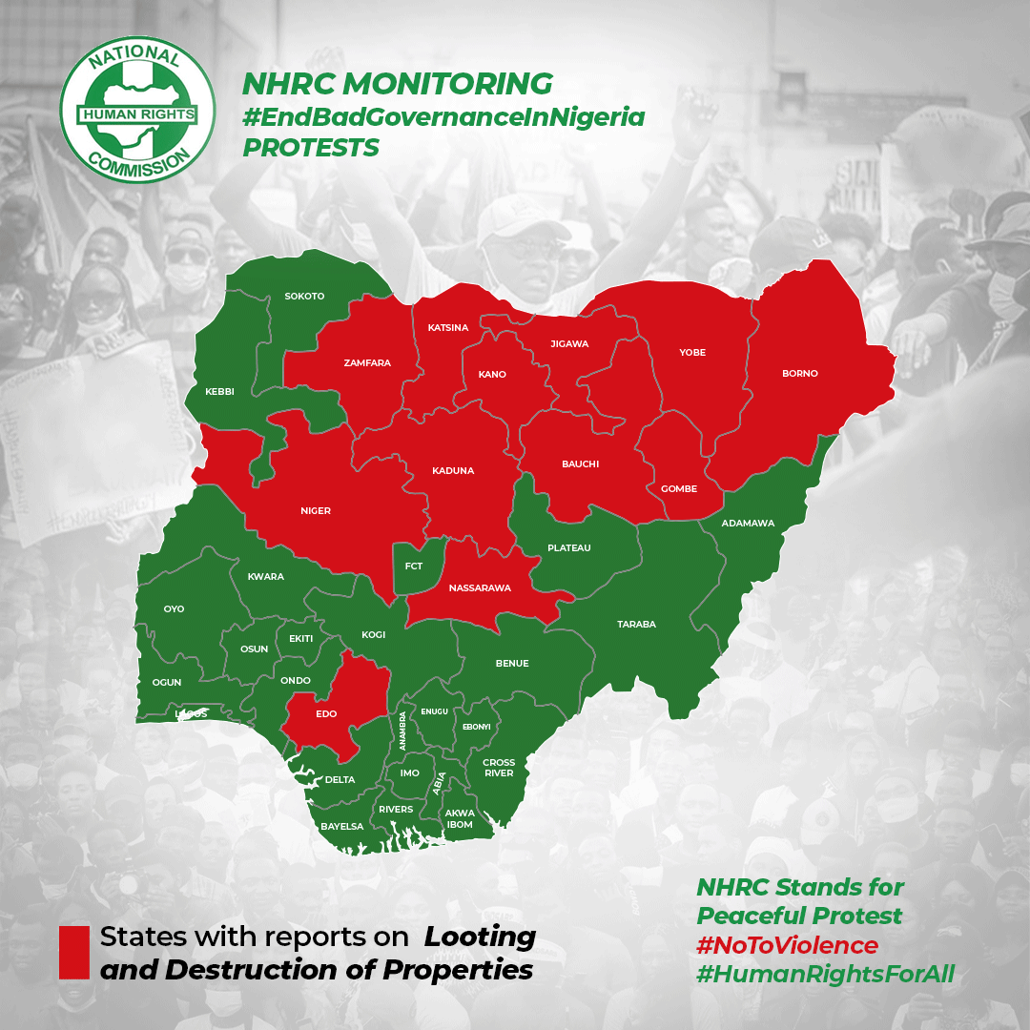

Slide 17
States in Focus
Sokoto
Edo
4 attacks by bandits/terrorists across the state leading to 87 and 56 abductions.
Killings by cultists in 3 incidents
Ebonyi
Double attacks on police stations

Slide 18
Issues in Focus
Freedom of Association & Peaceful Assembly
Flooding and Displacement
Killing of protesters across the country
Indiscriminate arrests and prolonged detention
Addressing the root causes of protests and discontents
Capacity of the state to protect lives and properties
Flooding and displacements violates a cocktail of human rights
Government and stakeholders should adopt human rights based approaches

Slide 19





NHRC July-August 2024 Human Rights Situation Dashboard
July-August 2024
Bob Attacks
Kidnapping
Killings
Child Abandonment
Killing of Security & Law Enforcement
3
2
365
340
4300
37
DESTRUCTION OF PROPERTIES
Gombe
Anambra
POLITICAL INTOLERANCE
Destruction/Cutting of Roads
Stoning of Governor Buni at APC Rally
Cancellation of PDP Rally
Kidnappings
POLITICAL VIOLENCE
Attack on NNPP Supporters
Attack on First Lady’s convoy
Attack on PDP Campaign DG
Attack on LP HOR Candidate
Attack on LP Supporters
Attack on Wife of PDP Candidate
briefs@nhrc.gov.ng

Slide 20

Acknowledgment
The NHRC is grateful to the United Nations Development Programme, the Office of the High Commissioner for Human Rights and GANHRI for their support to the Tripartite Partnership Programme (TPP).

Slide 21
Thank You

